Slide 1
MGS 723: Geodynamics
Class 6: Elasticity III

Slide 2
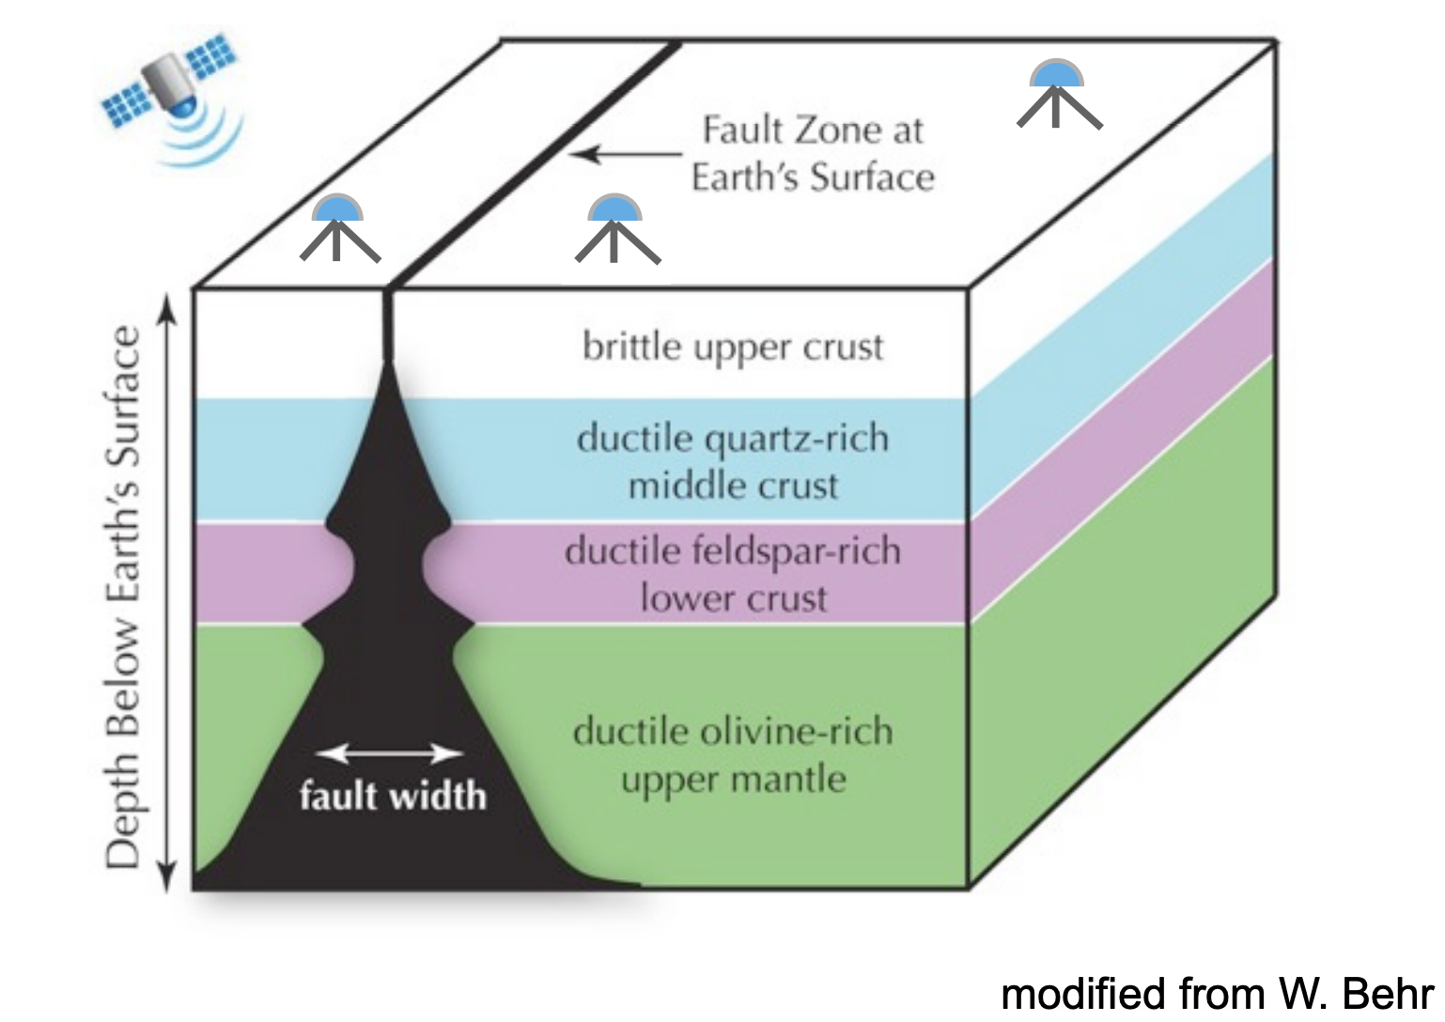
First, two points relating to the homework:
1) Viscous shear zones
Whitney Behr
While the lithosphere deforms elastically and brittle-y in the outermost layer (upper crust), the lower layers of the lithosphere can, and certainly does, deform viscously.

Slide 3
First, two points relating to the homework:
1) Viscous shear zones
Whitney Behr
While the lithosphere deforms elastically and brittle-y in the outermost layer (upper crust), the lower layers of the lithosphere can, and certainly does, deform viscously.
At depth, large faults can transition to viscous shear zones!

Slide 4
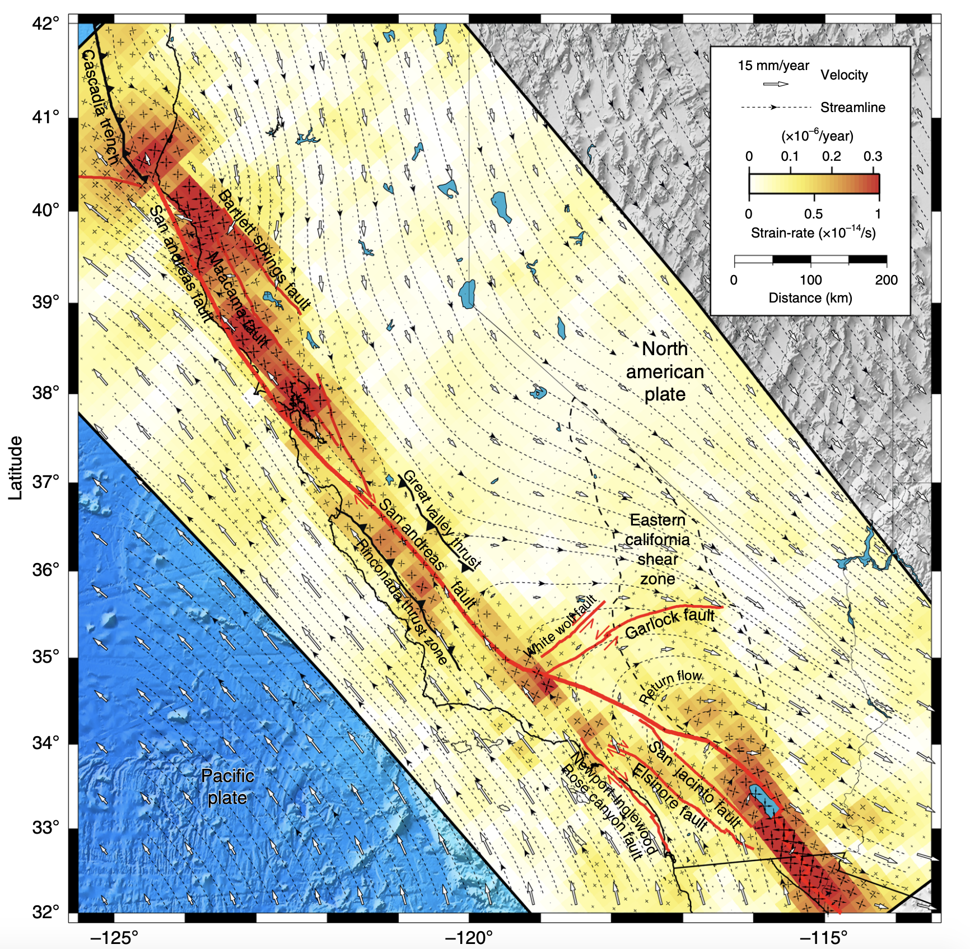
First, two points relating to the homework:
1) Viscous shear zones
Barbot, 2020, Nat. Comms.

Slide 5
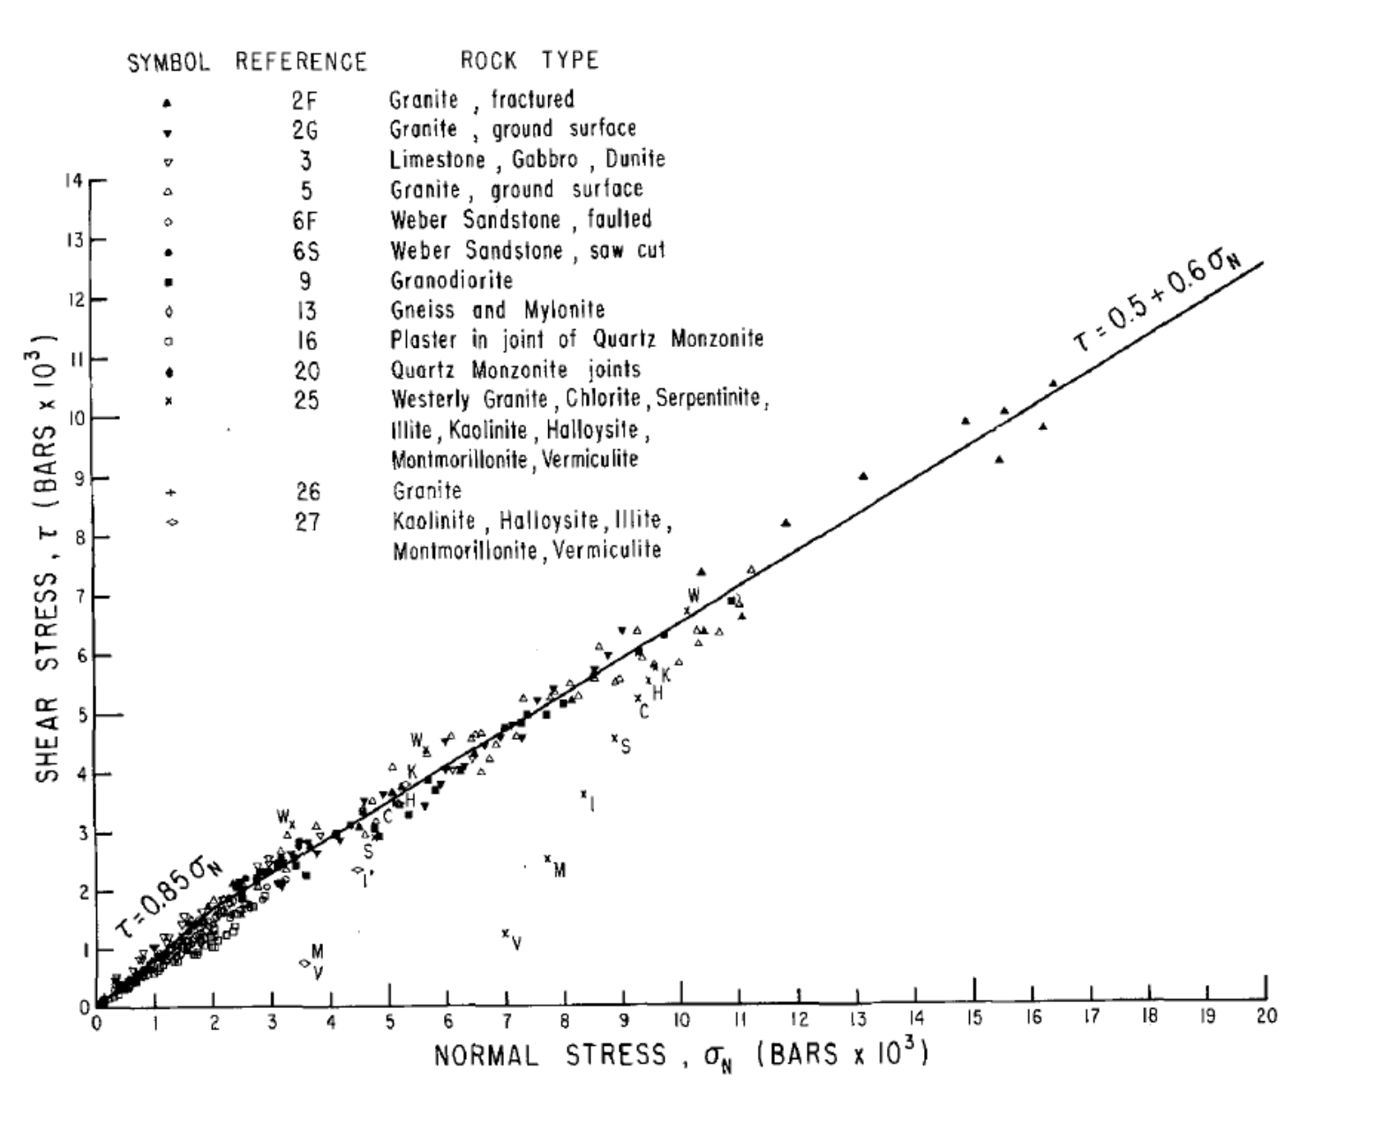
First, two points relating to the homework:
2) Byerlee faulting
Byerlee, 1978

Slide 6
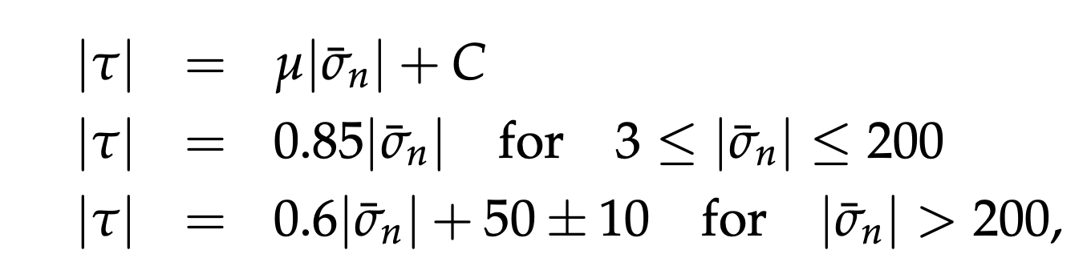
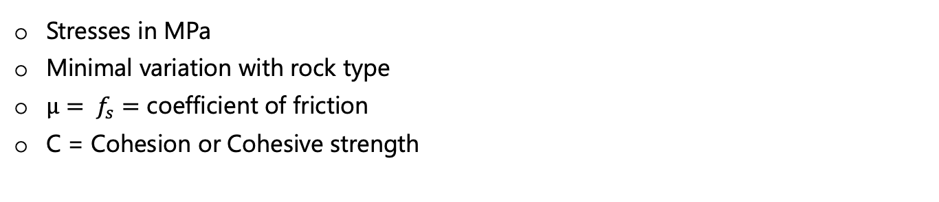
First, two points relating to the homework:
2) Byerlee faulting
Frictional sliding on fault planes at:
Stresses in MPa
Minimal variation with rock type
$μ= f_{s}=$ coefficient of friction
C = Cohesion or Cohesive strength

Slide 7
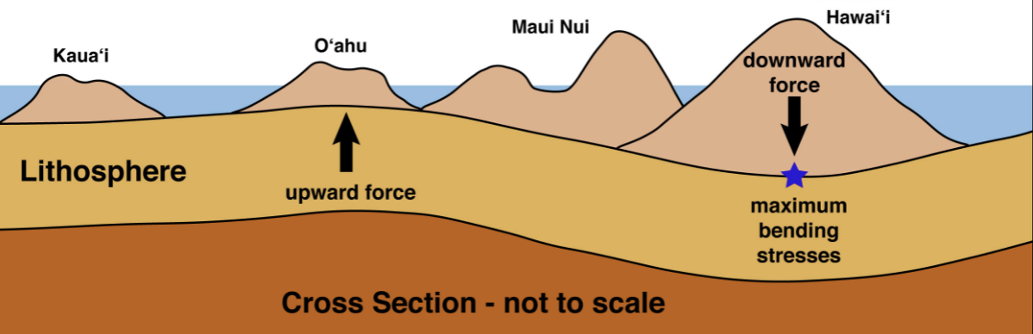
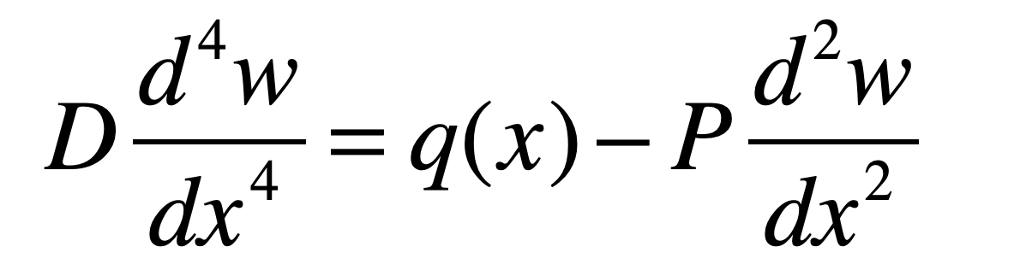
Back to the program: Plate flexure

Slide 8

To the stylus…
To: Some solutions for idealized plate flexure scenarios

Slide 9
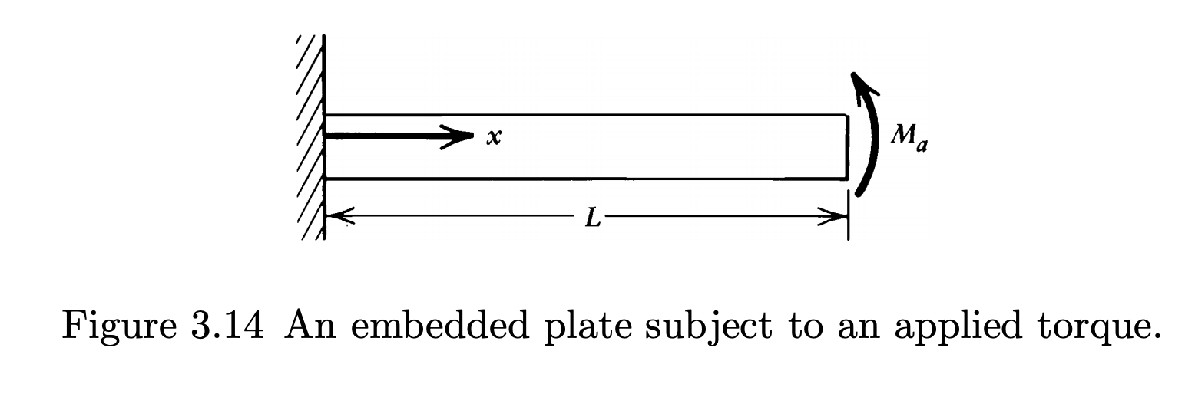
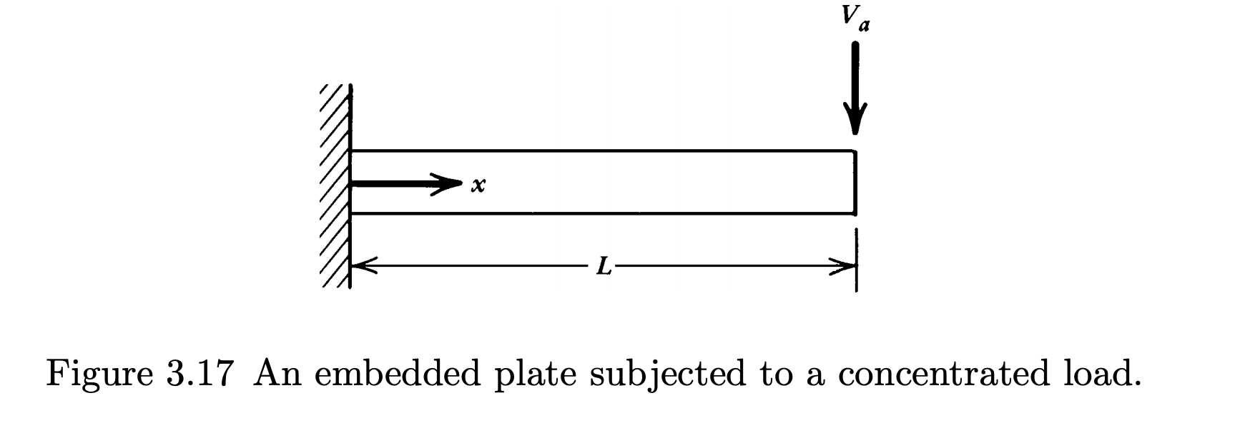
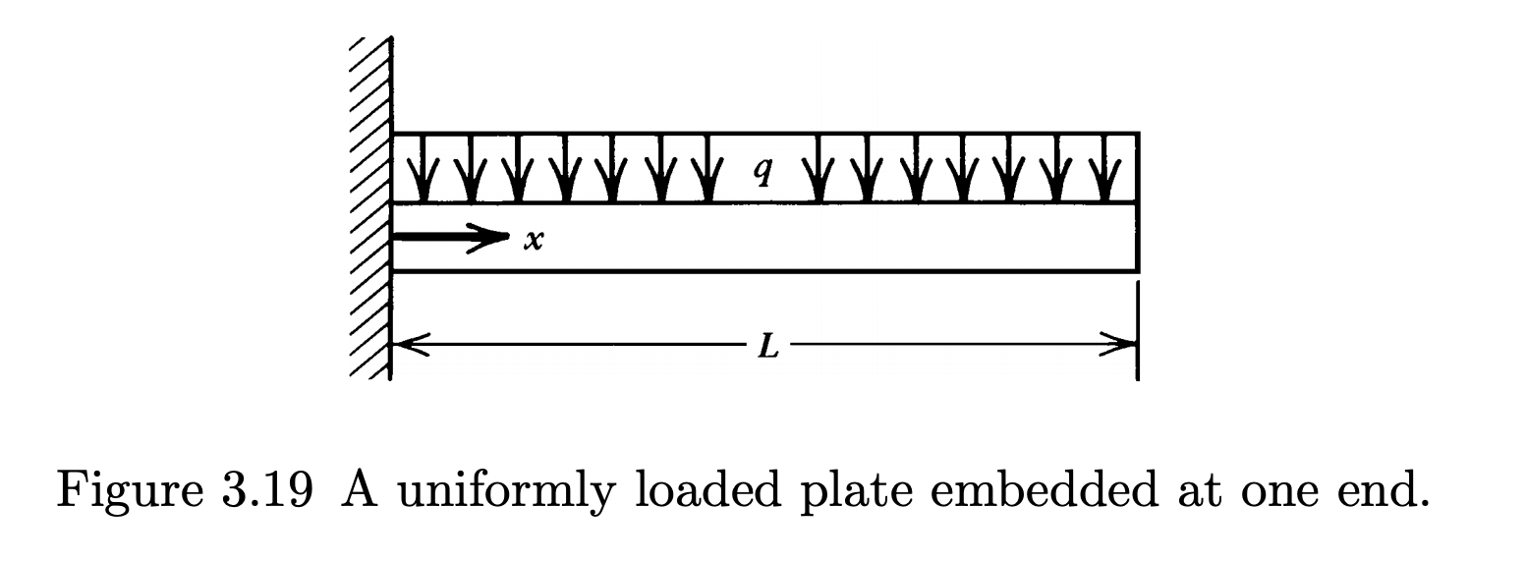
Idealized examples

Slide 10
Idealized examples
How to make applicable to Earth?

Slide 11
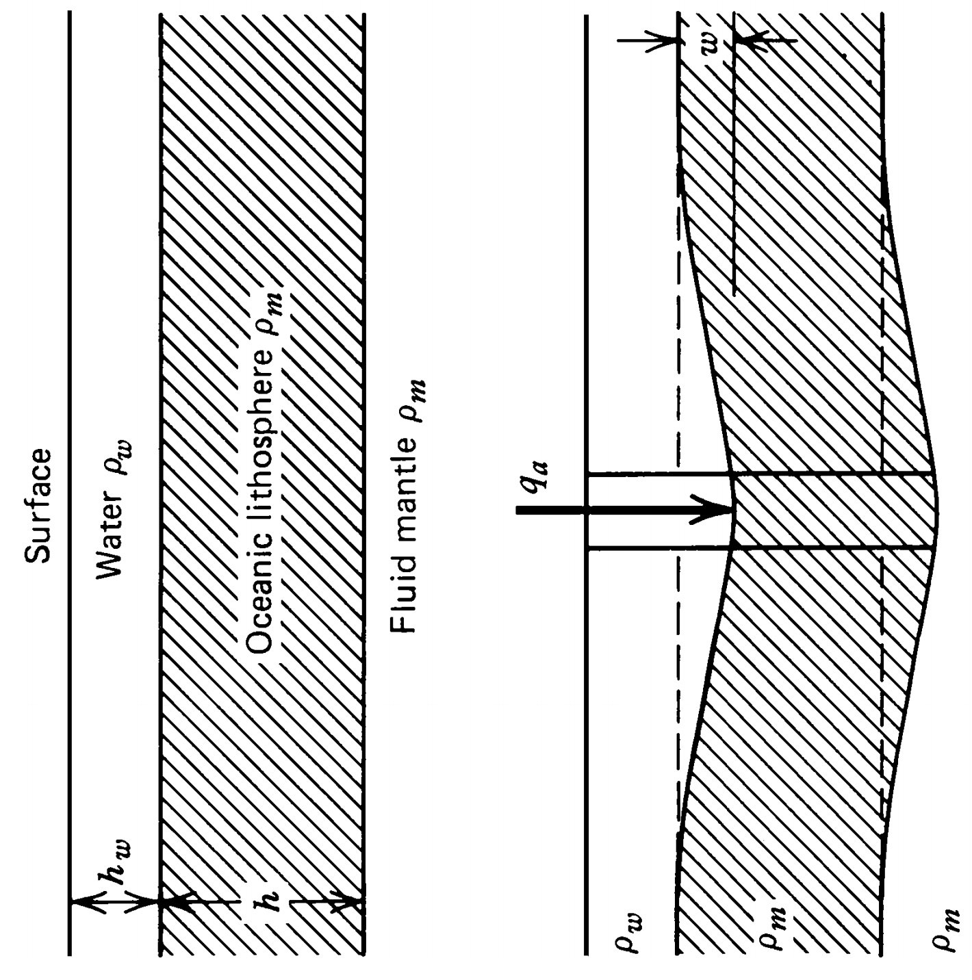
Idealized examples
How to make applicable to Earth?
In addition to the load (q_{a} ) there is a force associated with the in-fill of water:

Slide 12
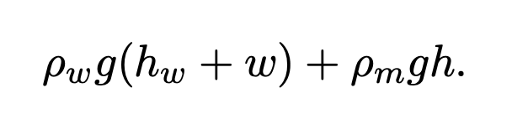

Idealized examples
How to make applicable to Earth?
(because not in isostatic equilibrium)
In addition to the load (q_{a} ) there is a force associated with the in-fill of water:
Hydrostatic force at base of deflected lithosphere:
Hydrostatic force at same depth of undeflected lith.:

Slide 13
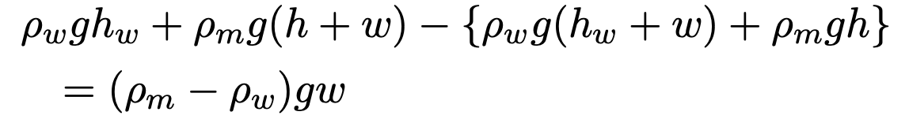
Idealized examples
How to make applicable to Earth?
(because not in isostatic equilibrium)
In addition to the load (q_{a} ) there is a force associated with the in-fill of water:
Hydrostatic force at base of deflected lithosphere:
Hydrostatic force at same depth of undeflected lith.:
Net (upwards directed) hydrostatic force:

Slide 14
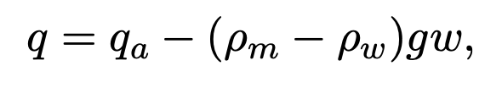
Idealized examples
How to make applicable to Earth?
(because not in isostatic equilibrium)
The (upwards directed) hydrostatic force tends to restore the lithosphere to its original position. Net force per unit area:

Slide 15
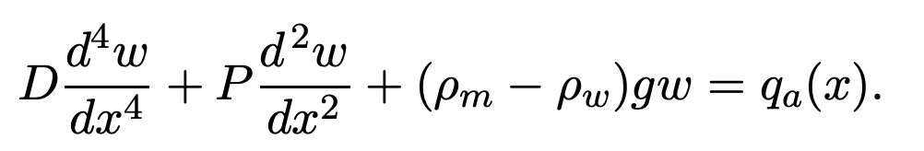
Idealized examples
How to make applicable to Earth?
(because not in isostatic equilibrium)
The (upwards directed) hydrostatic force tends to restore the lithosphere to its original position. Net force per unit area:
So:

Slide 16
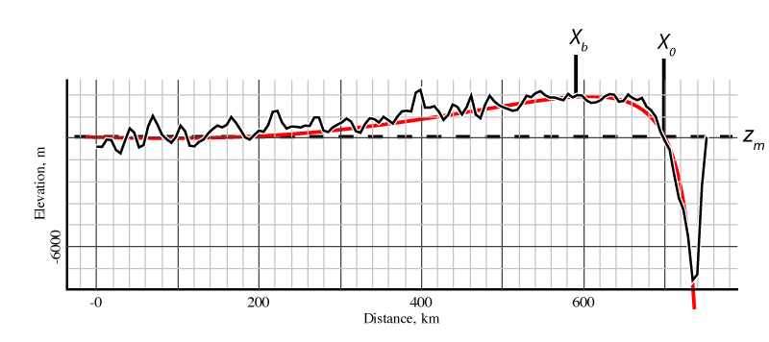
Idealized examples
How to make applicable to Earth?
Aleutian trench

Slide 17
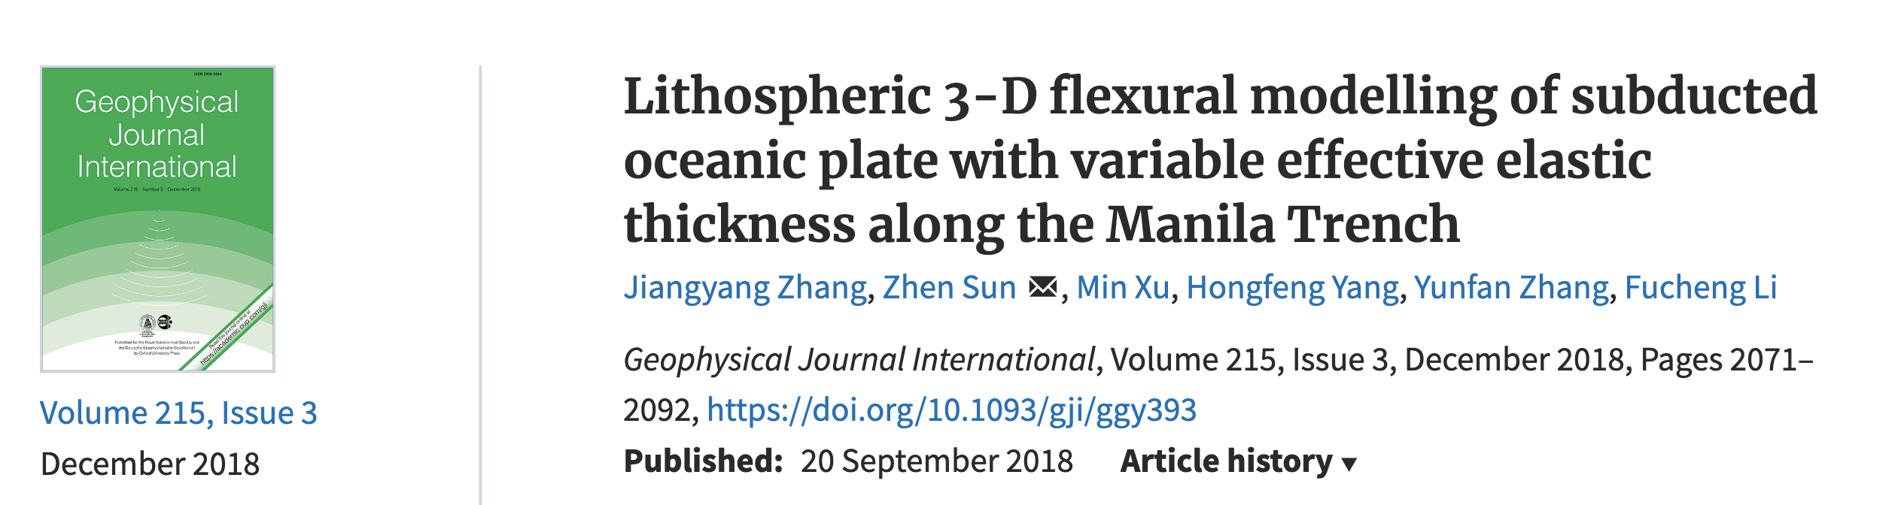
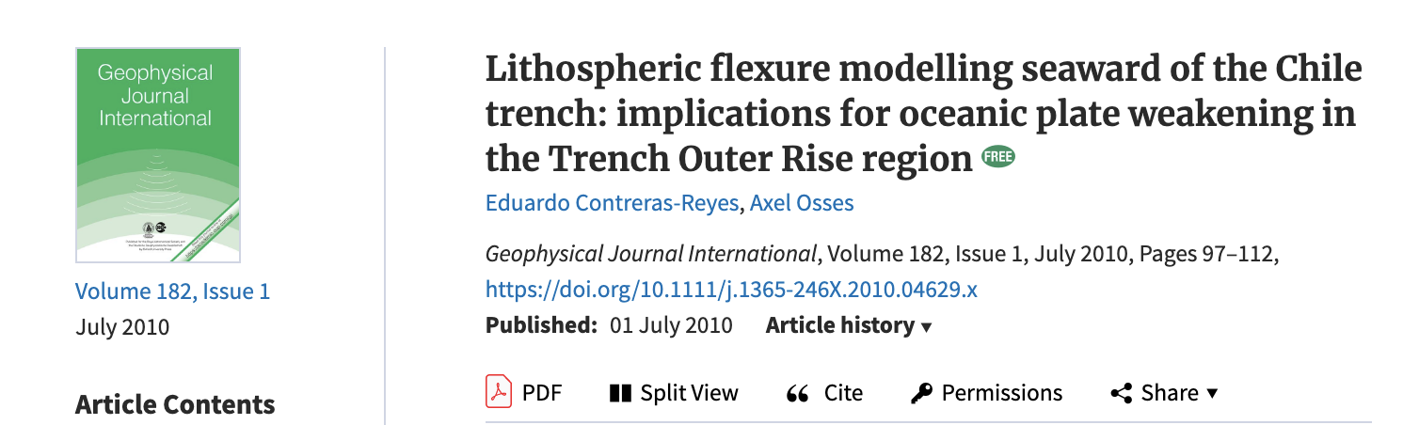
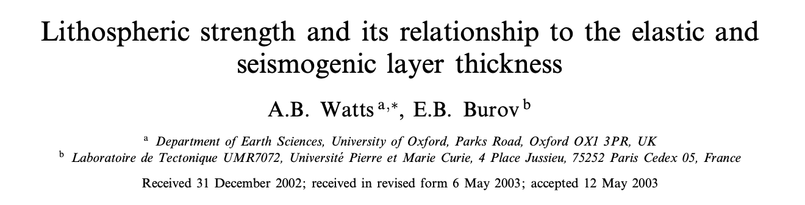
Idealized examples
How to make applicable to Earth?

Slide 18
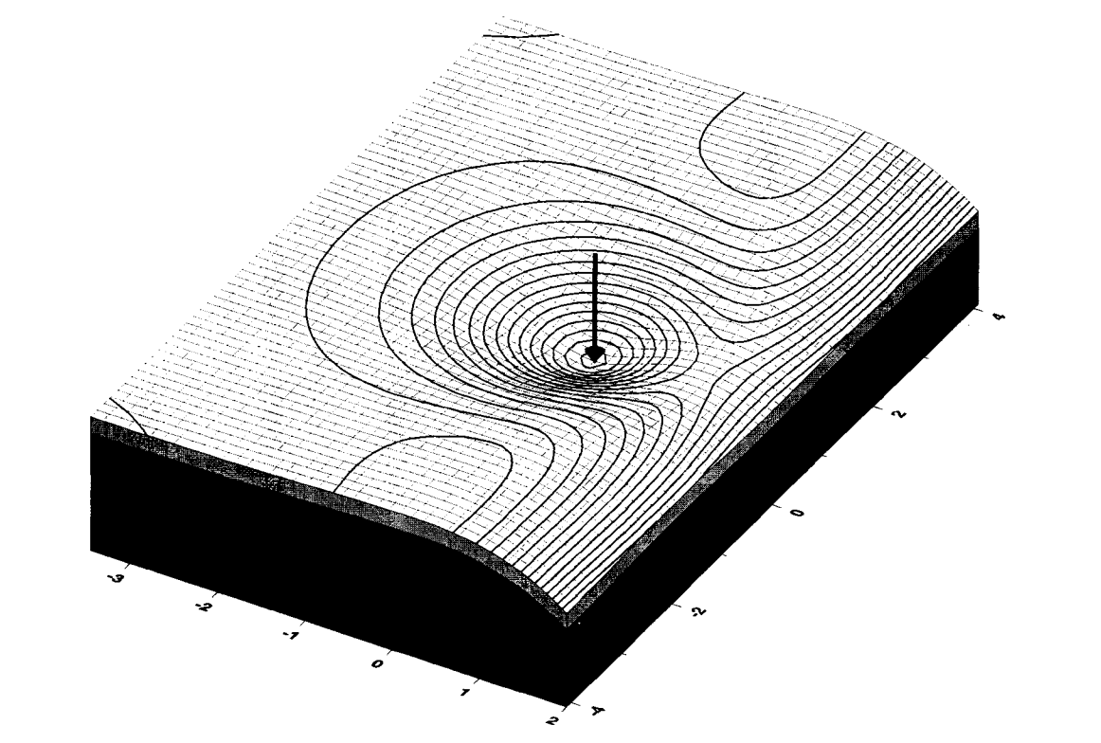
Idealized examples
How to make applicable to Earth?
Wessel, 1996

Slide 19
Take homes:
General equation for elastic plate flexure:
Expression (last class)
Assumptions (last class)
Example solutions
Modification for Earth lithosphere
Example applications include:
Subducting plates
Ocean islands
Folded strata
In all cases, can estimate the load, measure displacement, solve for plate properties.

